Slide 1
Bill Management Use Case
By
Kaushik Sen
Jayaram Kanduri
Akshay Satam

Slide 2
Current Inbound Bill Flow
Vendor
X12
WTX/ITX/EDI
Flat file
Host
XML
MQ
XML
WAS/ECS
ECS DB

Slide 3
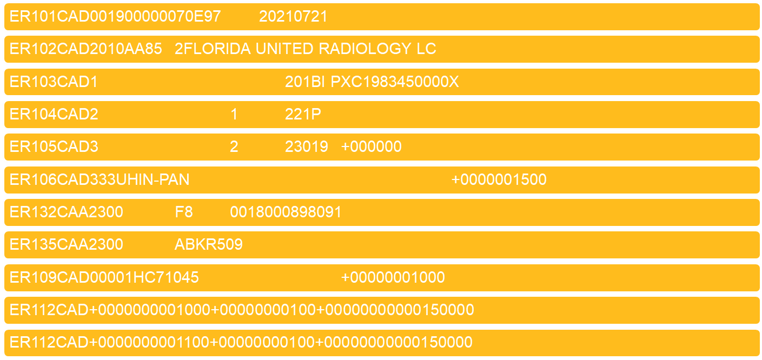
Flat File Format

Slide 4
X12 Format
ISA*00* *00* *01*123464321 *01*012361234 *141016*2359*U*00401*987800111*0*P*:​
GS*RA*123464321*012361234*141016*2359*987600113*X*004010​
ST*820*987800111​
BPR*C*77.77*C*ACH*CTX*01*234056789*DA*00999**123454321*01*045678099*DA*1073899*031016​
TRN*1*1410162359​
REF*AA*EDI6​
N1*PR*COMPANY NAME​
N3*COMPANY ADDRESS 1*COMPANY ADDRESS 2​
N4*COMPANY ADDRESS 3*STATE*ZIP​
N1*PE*TEST​
ENT*1​
RMR*AP*1111111111111111*PO*12.12​
RMR*AP*2222222222222222*PO*24.24​
RMR*AP*4444444444444444*PO*46.46​
DTM*055*141016​
SE*000000014*987800111​
GE*1*987800111​
IEA*1*987800111\​

Slide 5
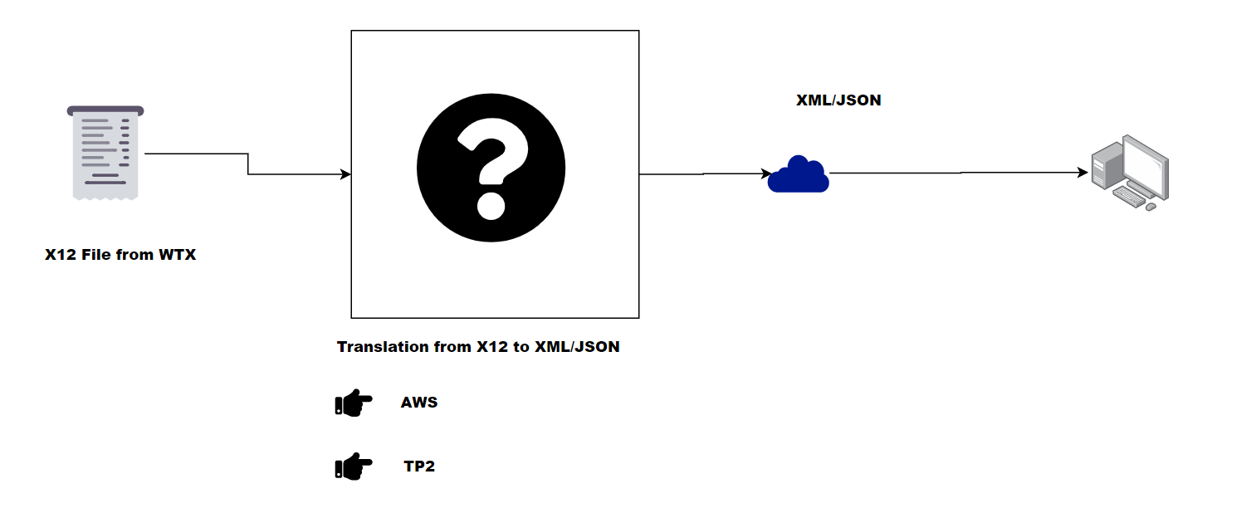
High Level Requirement

Slide 6
Requirement -
Store X12 file for audit
Parse X12 file into XML/JSON
Store parsed data in AWS
Store the data in DB2
Design a system that does async processing
Design an architecture in Cloud to reduce the on-prem costs.
Modernize to replace the legacy based mainframe systems.

Slide 7
Design Decision -
Why not TP2
Selection of AWS resources.
Need to design an aysnc system in cloud.
Store raw X12 and keep it for 10 years.
Store the parsed data.
Implement retry mechanism

Slide 8
Resources Used In AWS
API Gateway
Route 53
Lambda (for parsing and storing, calling SF API)
S3 Bucket
DynamoDB
SQS

Slide 9
Why API Gateway -
WTX has files from all vendors DDC, UHIN and Mitchell in X12 format.
Currently WTX is already making RESTful API calls to other services so more feasible option for WTX.
WTX will pass metadata using multipart upload according to which the files will be stored in respective buckets.
Serverless - Pay as you go model.

Slide 10
Why Lambda Function -
Serverless – Pay as you go model.
Logic to store on respective buckets based on Metadata which has information for different vendors.
Parsing Logic is required to convert the X12 structure into JSON/X12.
Lambda along with SQS can be used for re-processing if parsing fails or any logic fails to analyze the data later or implement retry mechanisms.
Call statefarm API with the parsed data.
Store data in dynamoDB table.

Slide 11
Why S3 -
Stores the X12 in its raw form
S3 Lifecycle policy can be used to move the files to infrequent access and then to Glacier/Glacier Deep Achieve to reduce the costs.
Requirement to store the file for 10 years with minimum available costs.

Slide 12
Why S3 event notification -
To make the app async and process whenever an X12 file is uploaded in s3 bucket.
Triggering mechanism to implement the parsing logic as soon as the document is uploaded in S3 bucket.

Slide 13
Why DynamoDB table
Stores the parsed JSON
Bill has different versions so to store the data using partition key
Can be used to analyze the data if something fails in production as JSON is easy to read compared to X12
To accommodate for future design if its decided later to orchestrate the whole flow in AWS.

Slide 14
Why SQS -
Retry mechanism can be implemented
Dead later queue stores the data if the data fails to process after retries.
Data from DLQ can be analyzed later by support analyst.

Slide 15
Why Route 53?
Use Amazon Route 53 alias records to map custom domain names (such as api.example.com, api.billmgmt.statefarm) to API Gateway.
Hides AWS URL
The API gateway URL changes every time it is deployed

Slide 16
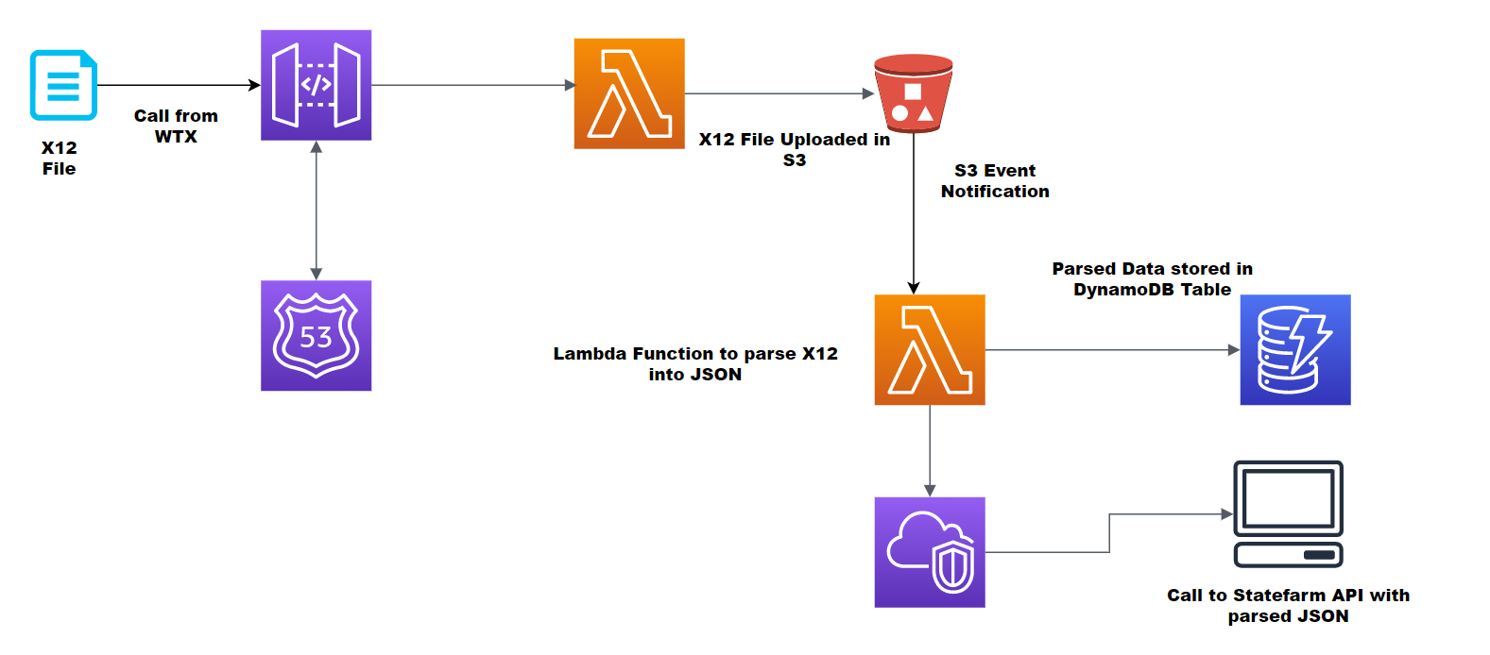
AWS Flow Diagram

Slide 17
X12 Input -
Input –
country*India
capital*New Delhi
national_bird*Peacock
national_animal*Tiger
national_flower*Lotus

Slide 18
Output -
Output –
{
"country": "India",
"capital": "New Delhi",
"national_bird": "Peacock",
"national_animal": "Tiger",
"national_flower": "Lotus"
}

Slide 19
Questions

